Slide 1

IT Management, Simplified
Real-time IT management solutions for the new speed of business

Slide 2
Envisioning the service desk as
the control center of IT
Staying on top of network alarms and failures

Slide 3






Functions of a centralized IT service desk
Device
management
IT operations
management
IT security
IT service
management
Active Directory management
IT analytics
The problem: They all work in silos
Notes:
2 way representation-with out details

Slide 4



The implications
No proper streamlined IT service desk processes, and reduced productivity.
Lack of control and visibility over the IT environment.
Inability to gain insights from the help desk data to support decisions.
Notes:
2 way representation-with out details

Slide 5
How centralized IT service desks should work
IT analytics
Active Directory management
IT security
IT service
management
Device
management
IT operations
management
Notes:
2 way representation-with out details

Slide 6
Story time
The tale of Zylker and its IT team.

Slide 7








Say hello to Zylker
Business users
IT folks
MARCUS
CIO
WENDY
HR
CATRIN
IT SERVICE DESK MANAGER
DAVE
HIRING MANAGER
JOHN
END USER
JASON
IT TECHNICIAN
SCOTT
IT TECHNICIAN
ADAM
IT TECHNICIAN

Slide 8
When IT was blind at Zylker.
IT challenge: Staying on top of network alarms and failures.

Slide 9










An influx of incidents
8:30AM
Business begins. Wendy is unable to access email.
10:15AM
Mail service is up, and all tickets are resolved.
8:00AM
Mail servers are down.
10:10AM
Servers are up and running.
8:32AM
Catrin has 87 tickets related to mail issues.
REACTIVE RESPONSE.
SLOW FIX.
MORE BUSINESS IMPACT.
9:30AM
Scott finds out that the mail server is down.
10:00AM
Scott works on the issue and fixes the servers.
8:33AM
Catrin assigns all tickets to Scott.

Slide 10
Better control and visibility of IT environment
with
ServiceDesk Plus

Slide 11
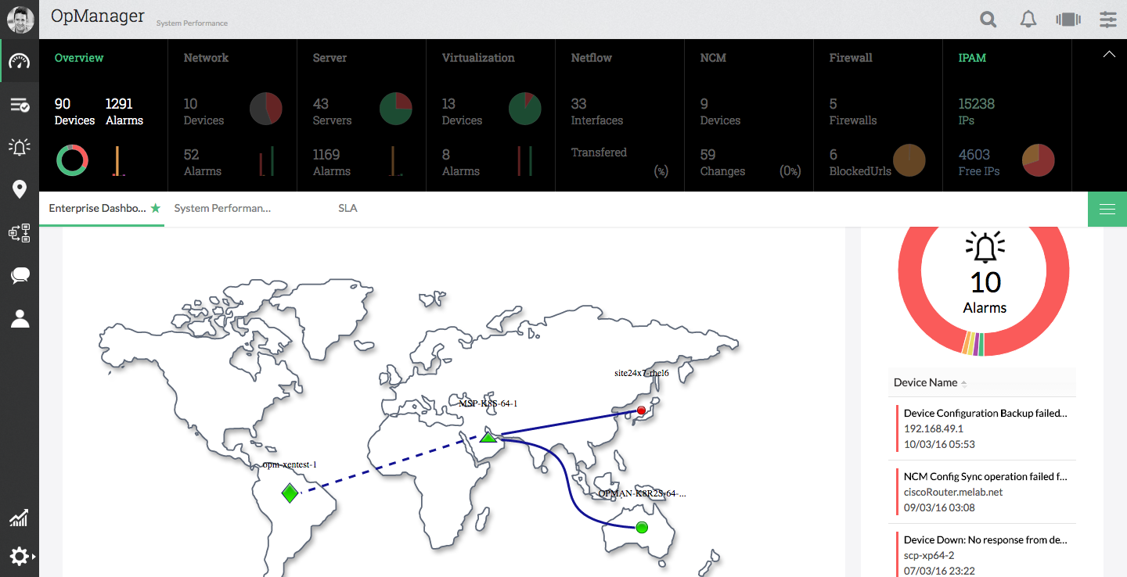
Catrin integrates ServiceDesk Plus with
OpManager

Slide 12
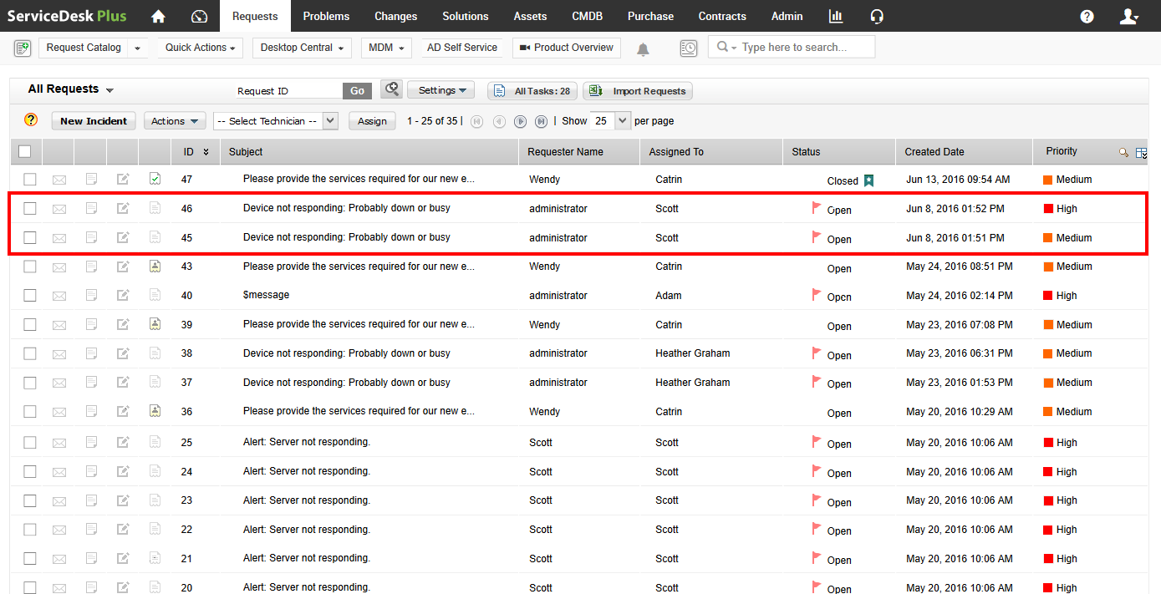
The network alarm detected by OpManager is automatically converted as a ticket in ServiceDesk Plus. The ticket is then assigned to Scott with its category, subcategory, and priority set.

Slide 13
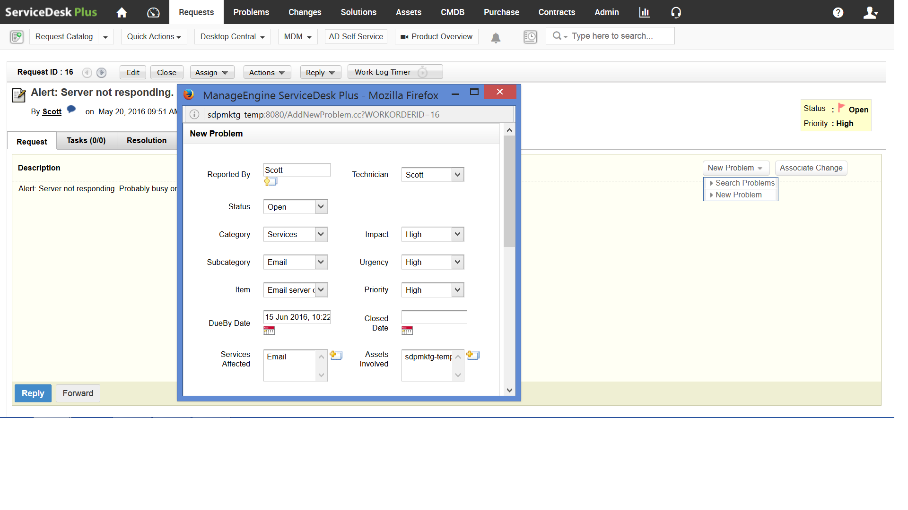
Scott, investigates the incident and fixes it before business begins at Zylker. He also links all the incidents associated with the mail server and initiates a problem analysis.

Slide 14
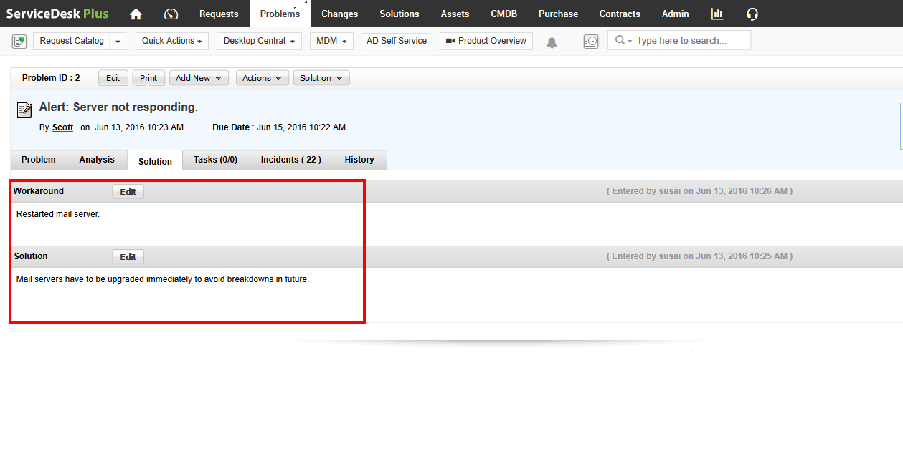
Scott, upon investigation finds that the mail servers have to be upgraded and reports it to Catrin.

Slide 15
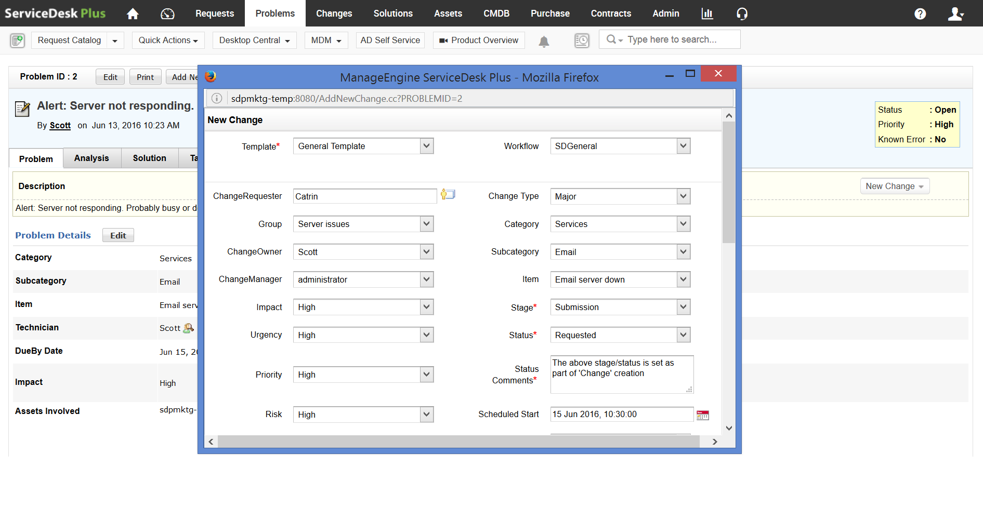
Catrin initiates a change proposal from within the problem to make sure that the mail server issues don’t occur again. She also adds Marcus as a CAB member to approve the change implementation.

Slide 16

The smarter way
8:00AM
A ticket is automatically logged into the help desk from OpManager and assigned to Scott.
The team implements the change.
8:00AM
Mail servers are down.
9:40AM
Marcus approves the change proposal.
8:20AM
Scott fixes the issues and servers are up again.
PROACTIVE RESPONSE.
QUICKER FIX.
MINIMAL BUSINESS IMPACT.
9:00AM
Scott filters all mail server alarm tickets, links them, and initiates a problem analysis.
9:30AM
Catrin realizes that there are too many issues from the same mail server and initiates a change to replace the existing old server.
8:30AM
Business begins as usual.

Slide 17
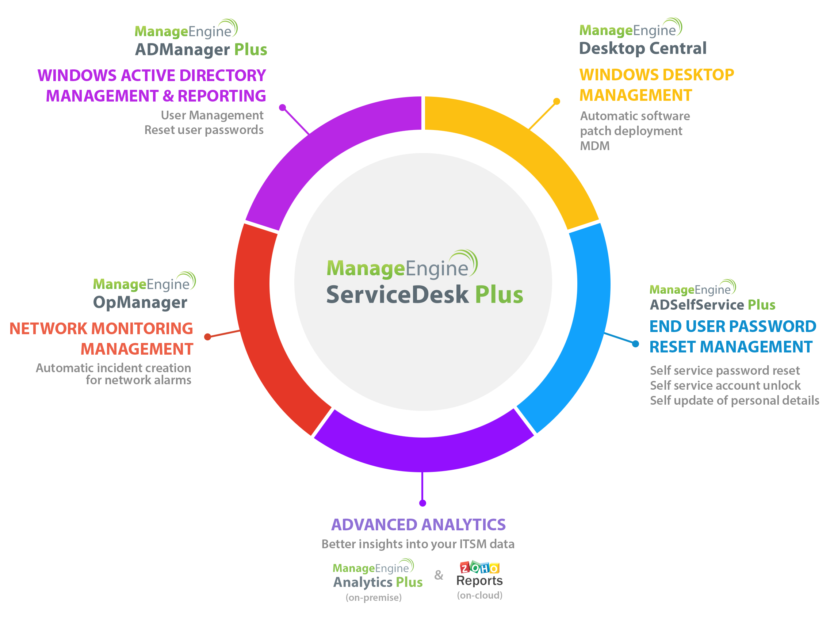
Building a
centralized
IT service desk
with
ServiceDesk Plus

Slide 18


“ ”
ServiceDesk Plus has been a great decision both functionally and financially.
James Arnold service desk manager Manhattan Associates
Join the
100,000+
happy service desks worldwide
Sign up for a 30-day free trial now.

Slide 19

Thank you!
hello@servicedeskplus.com

